Slide 1

Micro Services, REST and Spring Boot
How they complement each other to create a ‘bootiful’ design
Prashanth Batchu
Notes:
Have jdk/bin folder open
Have putty ready

Slide 2
About me
Part of the MyHealth team at Intermountain healthcare
Grew up in Hyderabad, Southern India.
Introduced to C by an amazing teacher in high school. Knew what I was going to make a career out of very soon.
Big fan of Open source software and it’s philosophy.
Always humbled and excited to be part of this very dynamic Software Industry that is always on the edge and is always advancing.
Notes:
Have jdk/bin folder open
Have putty ready

Slide 3
Agenda
Introduction to Spring Boot
Philosophy, goals, features, benefits and limitations
How to?
Live Demo
REST principles
Micro-services
How they complement each other
Q&A
Note: Slides and the source code are available on Github - https://github.com/batchu/spring-boot-ujug

Slide 4
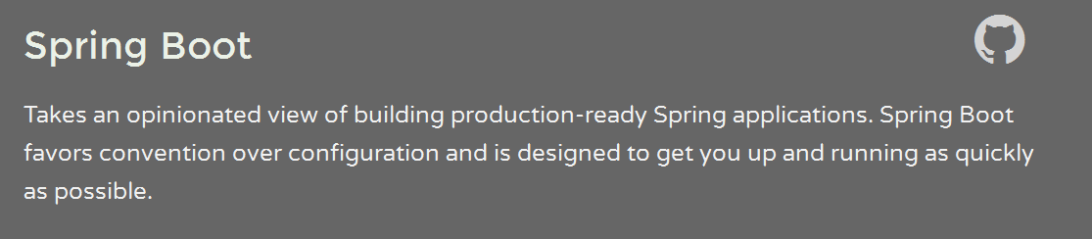
Primary goals:
Rapid development
Opinionated out of the box
Provide a range of non-functional features
No requirement for XML configuration.
Notes:
Spring Boot makes it easy to create stand-alone, production-grade Spring based Applications that you can “just run”.
take an opinionated view

Slide 5
Convention over Configuration
DRY Principle – Do not repeat yourself!
Start with sensible defaults
You should only have to configure something to use it for customization (non default setting).
Example: Did you include Logback in the classpath? Spring Boot will assume that you want to use it and will attempt to configure it.
Notes:
Example:

Slide 6
Spring Boot – Getting to know
App packaged as an executable jar* and runs on an embedded Tomcat.
Fully supports all of traditional Spring features (In a way Spring Boot is a layer on top of Spring infrastructure)
Out of the box Production ready management/monitoring features including Auditing, Tracing, Metrics and Process monitoring.
Cloud deployment support - Heroku, Openshift, Cloud Foundry, Google app engine etc.
Notes:
Example:

Slide 7
Spring Boot – Getting started
Initializer class with a Main method – Entry point of the app
Maven – Parent (spring-boot-starter-parent)*
Optional application.properties for custom/overriding default config
Auto-configuration
Notes:
Gradle and Ant are also supported

Slide 8
Spring Boot – Quick Demo
What are we going to build now?
A simple Bookmark app with JPA and an Embedded database
Environment: Eclipse IDE /w Spring Suite installed (or STS).
Steps:
Download a Spring starter project
Create a simple Endpoint for Hello
Create a Booking entity
Create a JpaRepository for Booking
Create a db init script
Expose an endpoint that serves the data
Ref: Building REST services with Spring

Slide 9
Spring Boot – Getting Help
Spring IO guides
http://start.spring.io/ or through Eclipse with Spring plugin/STS
Getting started guides: https://spring.io/guides
Spring Boot Reference Guide
On Stackoverflow

Slide 10
Spring Boot - Features
Externalized Config
Profiles
Logging
Static Content /w Live Reload & Hot Swapping for Java
Embedded Server customization
Security
SQL & NoSQL Database configuration
Testing
Messaging

Slide 11
Spring Boot – Features (Contd..)
Actuator (demo-jmx,http)
HATEOAS
Solr & Elasticsearch
Distributed Transactions – Atomikos/Bitronix
Monitoring & Management using Remote shell (demo -shell)
Custom Metrics
Cloud Deployment (Cloud Foundry, Heroku, Openshift, Goog App Eng)
Prototyping with Spring Boot CLI

Slide 12
REST – Representational State Transfer
Introduced by Roy Fielding.
It’s an architecture style. It’s not a protocol, standard or a framework
Resource-based – REST API is all about “things” or “resources” as opposed to “actions”
Representations – Typically JSON/XML
Not tied to HTTP
Ref: What is REST anyway? – Todd Fredrich

Slide 13
REST architectural style - Drivers
Heterogeneous Interoperability & Rise of Mobile
Services (API) have to be client agnostic
Mobile explosion: Client could be a GPS device, automotive, mobile etc.
Clients and Services need to evolve independently.
Latency issues, performance and reliability
Horizontal Scalability
Ref: REST fundamentals – Howard Dierking

Slide 14
How to derive REST style?
Roy Fielding talks about two approaches to design
Start with a clean slate to reach the desired design goals (Emphasizes creativity and unbounded vision)
Start with the system needs as a whole, without constraints and then incrementally identify and apply constraints to elements of the system in order to differentiate the design space and allow forces that influence system behavior to flow naturally. (Emphasizes restraint and understanding of the system context)
REST is derived through the second approach by adding “Constraints” to the design
Ref: Architectural Styles and the design of Network based Software Architectures – Roy Fielding

Slide 15
REST – Constraints
Constraints:
Uniform interface – Decouple client/server implementations using Standards . Interface is standardized across all components through principle of “generality”
Example:
Use URIs to identify resources ( /user/6)
HTTP methods for manipulation, self descriptive messages to client (GET, DELETE, POST..)
HTTP headers to describe messages (Content-Type: application/json)
Hypermedia as the engine of application state i.e HATEOAS
Stateless – Server maintains no client state (Each message has enough info/context for the server to process a message)
Client-server – Separation of concerns and a Uniform interface is the link
Cacheable –Server responses are Cacheable where appropriate to counter network latency/performance issues. Could be implicit/explicit/pre-negotiated
Layered system – Components are layered.
Code on demand (Optional)– Service can temporarily extend client
Ref: What is REST anyway? – Todd Fredrich,
REST – What is meant by uniform interface
Creating REST-ful, Hypermedia based Microservices with Spring Boot

Slide 16
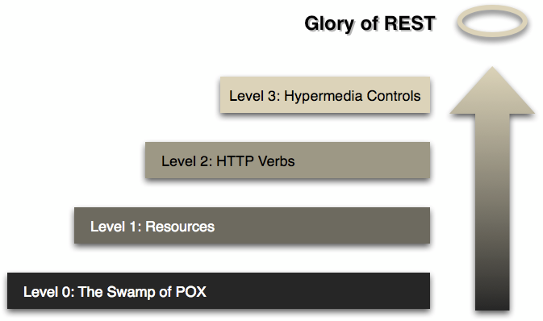
REST – Richardson’s Maturity Model
Level 0: the Swamp of POX - at this level, we just use HTTP as a transport.
Level 1: Resources - at this level, a service might use HTTP URIs to distinguish between nouns, or entities, in the system. For example, you might route requests to /customers, /users, etc. XML-RPC is an example: it uses HTTP, and it can use URIs to distinguish endpoints. Ultimately, though, XML-RPC is not RESTful: it’s using HTTP as a transport for something else (remote procedure calls).
Level 2: HTTP methods- this is the level you want to be at. If you do everything wrong with Spring MVC, you’ll probably still end up here. At this level, services take advantage of native HTTP qualities like headers, status codes, distinct URIs, and more. This is where we’ll start our journey.
Level 3: Hypermedia Controls - This final level is where we should strive to be. Hypermedia, as practiced using the HATEOAS
Ref: Richardson Maturity Model – Roy Fielding
Notes:
You could call SOAP a Level 0 technology. It uses HTTP, but as a transport. It’s worth mentioning that you could also use SOAP on top of something like JMS with no HTTP at all. SOAP, thus, is not RESTful. It’s only just HTTP-aware.

Slide 17
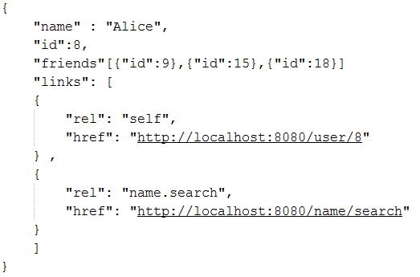
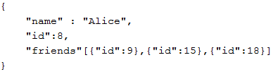
Hypermedia as the engine of application state (HATEOAS)
Help client navigate the Service API by providing necessary information dynamically in the response using media types and link relations
Helping client to navigate the API with Hypermedia links
No Hypermedia
Ref: Understanding HATEOAS

Slide 18
CRUD using HTTP methods (*as per the RFCs)
GET | PUT | POST | DELETE | PATCH
Retrieve a resource. RFC 2616. | Create or replace a resource in its entirety at the Client defined URL. RFC 2616. | Add a child resource at a Service defined URL. RFC 2616. | Delete a resource. RFC 2616. | Send instructions on how the Service should modify a resource. RFC 5789.
Safe/Idempotent | Safe/Idempotent | Not Idempotent | Not Idempotent | Can be made Idempotent but isn’t required to be.
GET /user/6 | PUT /user/6/friend/7 {“Name”: “Jane Doe”} | POST /users {“Name”: ”Jane Doe”} | DELETE /user/6 | [ {“increment": "/count/5", “by": 7} ]
Idempotence: The side-effects of N > 0 identical requests is the same as for a single request
Ref: RFC 2616, RFC 5789

Slide 19
HTTP status codes
1XX – Informational | 2XX – Success | 3XX – Redirection | 4XX – Client Error | 5XX – Server Error
100 Continue 102 Processing | 200 OK 201 Created 202 Accepted | 301 Moved Permanently 302 Found 304 Not Modified | 400 Bad Request 401 Unauthorized 403 Forbidden 404 Not Found 405 – Method Not Allowed | 500 Internal Server Error 501 Not Implemented 502 Bad Gateway 503 Service Unavailable
Ref: HTTP 1.1

Slide 20
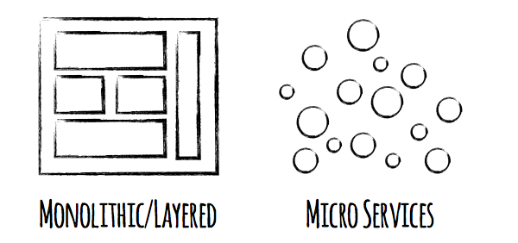
Micro services
Developing a single application as a suite of small services, each running in its own process and communicating with lightweight mechanisms, often an HTTP resource API.
Ref: Microservices – Martin Folwer
Image: Courtesy of Eugene Dvorkin

Slide 21
Micro-services architectural style
Characteristics:
Componentization via Services
Organized around Business Capabilities
Products not Projects – You build it, you own it
Smart endpoints and dumb pipes – (Unlike an ESB with dumb endpoints and smart pipes)
Decentralized Governance
Decentralized Data Management
Infrastructure Automation
Design for failure
Evolutionary Design
Ref: http://martinfowler.com/articles/microservices.htmlc
Notes:
component is a unit of software that is independently replaceable and upgradeable.

Slide 22
Micro-services - Characteristics
Componentization via Services
Component: Unit of software that is independently replaceable and upgradeable
Limit the scope of re-compilation/re-deployment to as low as a single component as opposed to recompiling and redeploying the entire monolithic application
Downside: Remote calls are more expensive than in-process calls
Organized around Business Capabilities
When splitting a large app, don’t just focus on the technology layer but ensure that it’s organized around business capabilities and organizational (team) structures
Ref: http://martinfowler.com/articles/microservices.html
Notes:
component is a unit of software that is independently replaceable and upgradeable.

Slide 23
Micro-services - Characteristics
Products not Projects – You build it, you own it
Treat them like “Products” instead of “Projects”
Developers (or teams) own the Product and be involved post-deployment
Smart endpoints and dumb pipes – Be of the web, not behind the web
Unlike an ESB with dumb endpoints and smart pipes
Each component should have a purpose, meet specific business need(s)
Ref: http://martinfowler.com/articles/microservices.html
Notes:
component is a unit of software that is independently replaceable and upgradeable.

Slide 24
Micro-services - Characteristics
Decentralized Governance
Centralized Governance has a tendency to standardize on single technology platforms, which can be constricting
Each micro service may take advantage of a specific technology stack to achieve it’s purpose. Eg: Use single threaded node.js stack for a Micro Service that serves as the entry point/arbitrator of incoming requests.
Contrasts SOA architecture
Decentralized Data Management
Conceptual model of the world differs between systems and problems
Splitting Monoliths into Micro Services lets you decentralize data storage decisions to each individual component when appropriate
Ref: http://martinfowler.com/articles/microservices.html
Notes:
component is a unit of software that is independently replaceable and upgradeable.

Slide 25
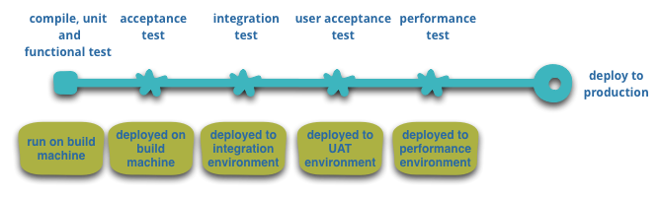
Micro-services - Characteristics
Infrastructure Automation
Embrace “Continuous Integration” principles to the fullest extent. Run lots of automated tests and automatically promote the build to the next logical environment
Basic build pipeline
Ref: http://martinfowler.com/articles/microservices.html
Notes:
component is a unit of software that is independently replaceable and upgradeable.

Slide 26
Micro-services - Characteristics
Design for failure
Murphy’s Law: Whatever can fail will fail eventually
Micro Service style does introduce some complexity as you now have multiple components running independently although failure (depending upon the type of failure) can be localized or widespread across the pool.
Put emphasis on Real-time monitoring (Spring Boot Actuator eh?)
Have automated production infrastructure tests.. something like Netflix’s Simian Army that induces failures of services and even datacenters during the working day
Ref: http://martinfowler.com/articles/microservices.html
Notes:
component is a unit of software that is independently replaceable and upgradeable.

Slide 27




Monolithic challenges
A typical Java App with Spring MVC
json/*-form-urlencoded
Controllers
(Endpints)
Services
(Interfaces)
DAO
(Persistence)
Return jsp/html
html
Model
User
Mgmt.
Core Business
3rd Party Integration
…
Security
Orders

Slide 28
Monolithic challenges
How Scalable is this architecture? (Horizontal)
User
Mgmt.
10
Core Business.
100
3rd Party Integration
100
…
Security
20
Orders
100
Assume that the above is deployed to n nodes to facilitate horizontal scaling
Add weights to each piece of functionality/component/module
Weights are based on usage statistics, resource requirements, priority, business need etc.
Upon horizontal scaling, components with lower weights provide the least value
When deploying to other nodes, you will still need to compile the whole application (including the components with lower weights). Lower weighted components still take up JVM space
Harder to maintain over time.
Hard to re-write/refactor

Slide 29

Monolithic Challenges
What if I want to support mobile clients?
How can third party apps/services talk to my app?
One approach to support mobile/other clients is to add a layer of extra Spring controllers that serve JSON
This means that you will now have to support
Client dependent controllers that serve jsp/html to Browser clients
Client agnostic controllers that serve json to mobile/other clients
Modeling needs for the data to be returned vary significantly between the Client dependent Browsers and Client agnostic Mobile clients (other API consumers)
This is inefficient because now we will need to maintain duplicate codebases that serve the same data differently.

Slide 30
Monolithic Challenges
What about Performance?
Serving JSPs to clients is very inefficient
Generation takes up valuable Java EE server resources. Resources that are ought to be prioritized for number crunching, data processing etc.
Limiting a Service’s responsibility of client view management leads to better design and facilitates development of neutral client agnostic apis.
Data transfer between Service to client is huge – when transferring a jsp to client as opposed to something lightweight (json)
And this happens again and again as the user navigates from one page to another till the end of the session

Slide 31
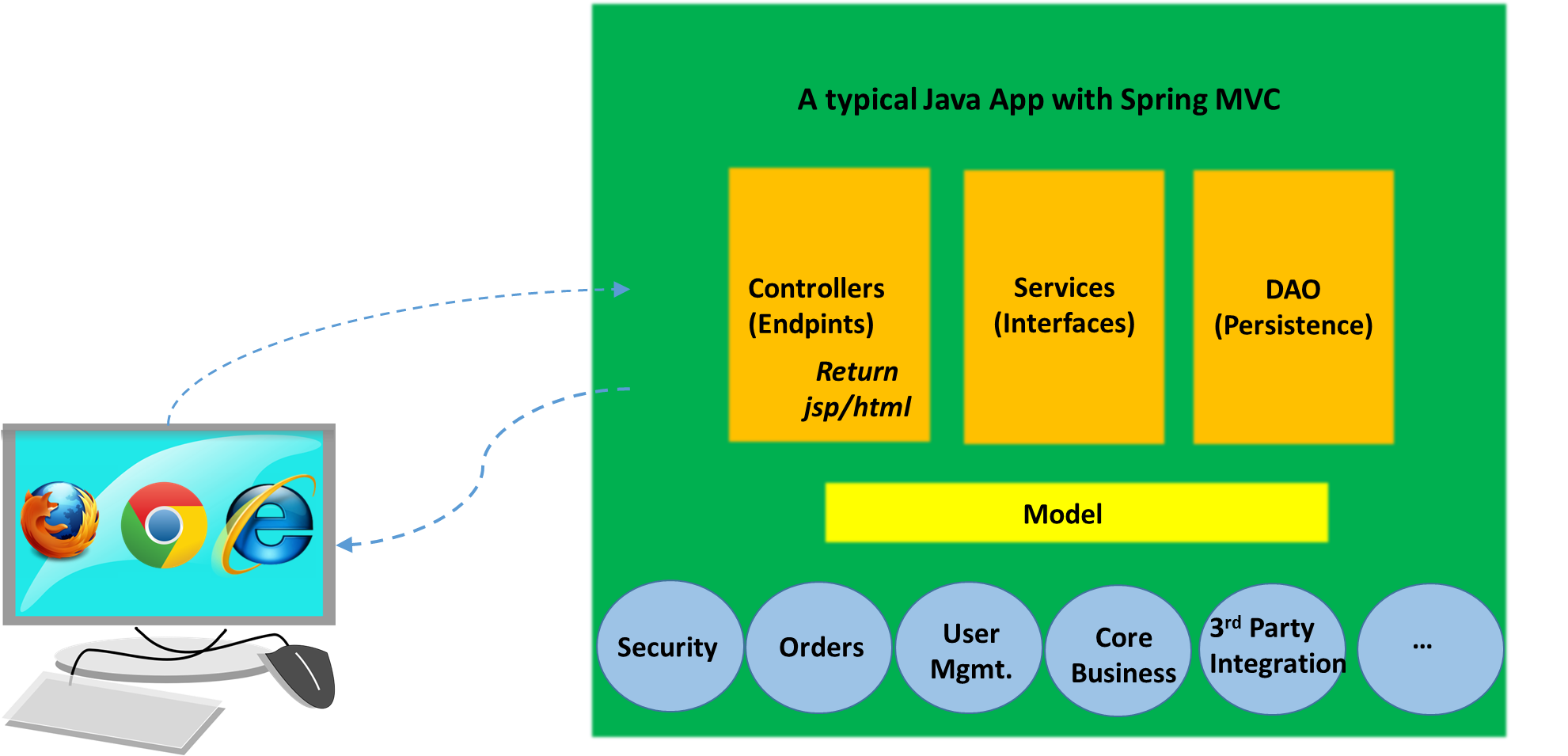
Can we improve on this?
Yes!
Usual legal stuff: There’s no silver bullet when choosing an architecture for a distributed network application. Design choices vary significantly based on underlying design goals and long term vision of the intended application.

Slide 32

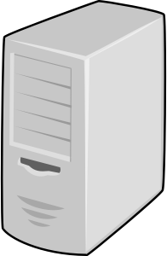





Scalable Micro Service Architecture
Static Repository
(Node.js/nginx)
Oauth Auth Server
6. Token validation request
7. Success
4. Token
3. Auth Request
1. Initial Request
Micro Service Pool
2. Html, JS, CSS
e
a
5. Resource request + Token + json payload
c
8. Response (json)
a1
(subsequent requests)
d
f
b
g

Slide 33
How Micro Services, REST style and Spring Boot complement each together
Spring Boot
Rapid development of Micro Services and REST endpoints
Embraces and facilitates the creation of RESTful Services
Actuator – Prod ready Monitoring features (as in “Design for failure” – Micro Services principle)
Enables Infrastructure automation (Another Micro Service principle)
REST architectural style
Confirming to REST constraints such as Caching, Separation of Concerns, Reliability, Statelessness facilitates the creation of richer, client agnostic and very powerful services with HATEOAS
It’s just a cleaner and a natural architectural style embracing simplicity and uniformity
Aides when dealing with the additional API documentation needs when you have multiple running Micro Services with the adoption of HATEOAS
Micro Services
Infrastructure automation, Independent evolution of components, Design for failure
Can be designed to fully complement REST constraints (Layered approach, Uniform Interface, Scalability, Client/Server and stateless)
Unbounded horizontal Scalability and support for Elastic Infrastructure
Improved manageability of Products, cleaner design principles and

Slide 34

Questions?

